Slide 1
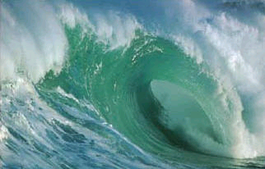
Surface Waves

Slide 2
Surface Wave
A wave that has characteristics of both transverse and longitudinal waves (Ocean Waves).
Surface Wave Applet

Slide 3
Surface Waves
Thus far, you have seen the profile view of waves.
How do these waves look from above?
Direction of propagation
Wavefronts
λ = Wavelength

Slide 4
Reflection of Surface Waves
The law of reflection states that the angle of incidence is equal to the angle of reflection.
Wave Crest
θ_{r}
Reflected Ray
θ_{i}
Normal
θ_{i} = θ_{r}
Incident Ray

Slide 5
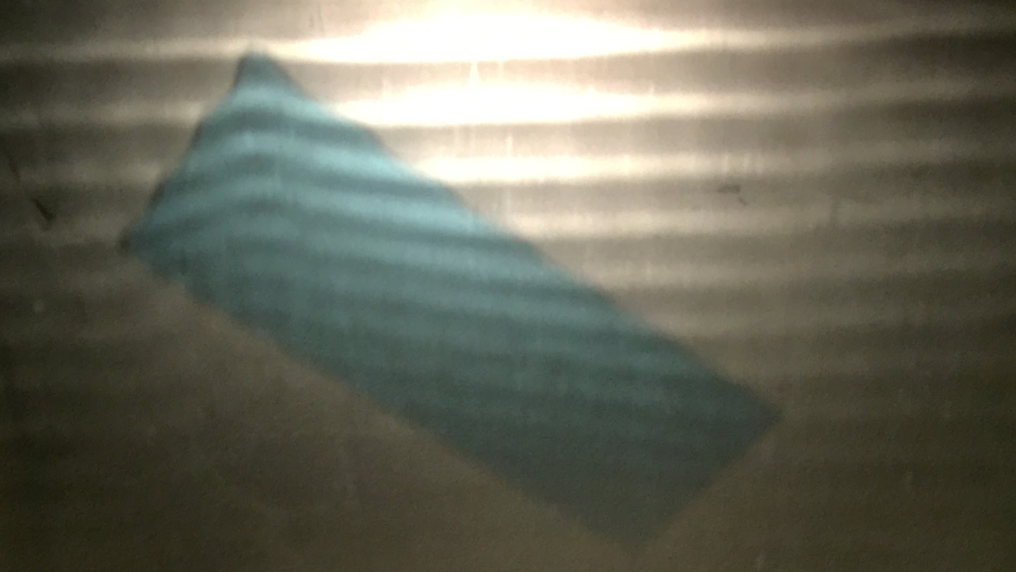
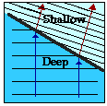
Refraction of Surface Waves
If the direction of the wave changes, then the wave is said to have refracted.
Refraction.

Slide 6
Refraction of Surface Waves
When surface waves move from deep water to shallower water:
The wavelength decreases.
The amplitude increases.
The speed decreases.
Why?
Because of interactions with the bottom.
Note: The frequency does not change!
$$λbefore$$
$$λafter$$
$λbefore$ in deep water is greater than $λafter$ in shallow water.
And since frequency is constant, the speed must decrease because $v=fλ$.

Slide 7
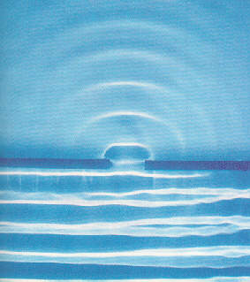
Diffraction
When a wave front is incident on a barrier with an opening, the wave will spread out after crossing the barrier. This process is called diffraction.
As the slit becomes narrower,
the amount of diffraction will
increase.
As the wavelength increases,
the amount of diffraction
increases.
Wavelength, frequency, and
hence velocity, do not change.
Diffraction

Slide 8
Interference
As per the principle of linear superposition:
Crests will combine with crests and troughs will combine with troughs in a constructive manner.
Where a crest meets a trough, interference will be totally destructive.
Constructive Interference
Destructive Interference

Slide 9
Key Ideas
Surface waves have characteristics of both transverse and longitudinal waves.
Waves transfer energy without transferring matter.
Waves can interfere with one another resulting in constructive or destructive interference.
The law of reflection states that angle of incident wave equals the angle of the reflected wave.
Diffraction is the spreading out of a wave when it encounters a barrier.

